Slide 1
Resampling Methods
Resampling methods are an indispensable tool in modern statistics. They
involve repeatedly drawing samples from a training set and refitting a model
of interest on each sample in order to obtain additional information about
the fitted model.

Slide 2
K-Fold
Shuffle the dataset randomly and set the seed.
Split the dataset into k groups
For each unique group:
Take the group as a hold out or test data set
Take the remaining groups as a training data set
Fit a model on the training set and evaluate it on the test set
Retain the evaluation score and discard the model
Summarize the skill of the model using the sample of model evaluation scores

Slide 3
Determining K in K-Fold
A poorly chosen value for k may result in a misrepresentative idea of the skill of the model, such as a score with a high variance, or a high bias, (such as an overestimate of the skill of the model).
Three common tactics for choosing a value for k are as follows:
Representative: The value for k is chosen such that each train/test group of data samples is large enough to be statistically representative of the broader dataset.
k=5 or 10: The value for k is fixed to 5 or 10, two values that have been found through experimentation to generally result in a model skill estimate with low bias a modest variance.
k=n: The value for k is fixed to n, where n is the size of the dataset to give each test sample an opportunity to be used in the hold out dataset. This approach is called leave-one-out cross-validation and that technique in caret should be used.

Slide 4
k-Fold with K = 5
Dataset
Training Set
Test Set
Fold 1
Fold 2
Fold 3
Fold 4
Fold 5
Find Parameters
Fold 1
Fold 2
Fold 3
Fold 4
Fold 5
Fold 1
Fold 2
Fold 3
Fold 4
Fold 5
Fold 1
Fold 2
Fold 3
Fold 4
Fold 5
Fold 1
Fold 2
Fold 3
Fold 4
Fold 5
Find Evaluation
Test Data

Slide 5
Performance = $\frac{1}{5}\sum_{i=1}^{5}{Performance}$
Validation Fold
Training Folds
Fold 1
Fold 2
Fold 3
Fold 4
Fold 5
Performance 1
Fold 1
Fold 2
Fold 3
Fold 4
Fold 5
Performance 2
Fold 1
Fold 2
Fold 3
Fold 4
Fold 5
Performance 3
Fold 1
Fold 2
Fold 3
Fold 4
Fold 5
Performance 4
Fold 1
Fold 2
Fold 3
Fold 4
Fold 5
Performance 5
Notes:
Average the parameters

Slide 6
Even Split in Observations?
If a value for k is chosen that does not evenly split the data sample, then one group will contain a remainder of the examples. It is preferable to split the data sample into k groups with the same number of samples, such that the sample of model skill scores are all equivalent.

Slide 7
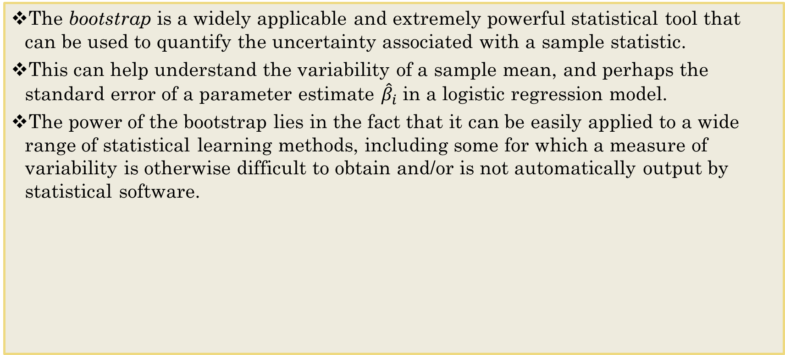
The Bootstrap
The bootstrap is a widely applicable and extremely powerful statistical tool that can be used to quantify the uncertainty associated with a sample statistic.
This can help understand the variability of a sample mean, and perhaps the standard error of a parameter estimate ${\hat{β}}_{i}$ in a logistic regression model.
The power of the bootstrap lies in the fact that it can be easily applied to a wide range of statistical learning methods, including some for which a measure of variability is otherwise difficult to obtain and/or is not automatically output by statistical software.

Slide 8
The Bootstrap
This method is used to quantify uncertainty.
It consists of randomly selecting a sample of n observations from the original data set.
This subset, called bootstrap data set, is used to evaluate the model.
This procedure is repeated a large number of times and the standard error of the bootstrap estimate is then calculated.
The results provide an indication of the variance of the models performance.
The sampling is performed with replacement, which means that the same observation can occur more than once in the bootstrap data set.

Slide 9
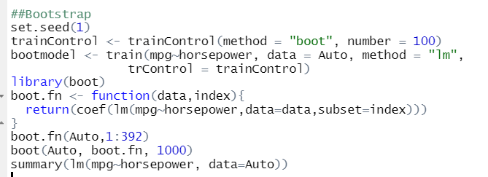
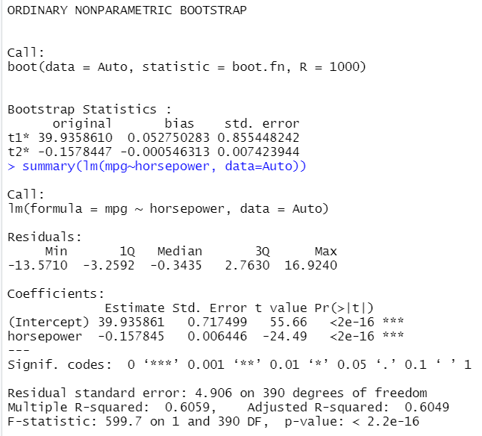
The Bootstrap Function
You can note that using the standard lm() function gives a slightly different standard errors, because the linear model makes some assumptions about the data. The bootstrap approach does not rely on any of these assumptions made by the linear model, and so it is likely giving a more accurate estimate of the coefficients standard errors than using the summary() function

Slide 10
Complexity of Bootstrap
The bootstrap method is a statistical technique for estimating quantities about a population by averaging estimates from multiple small data samples.
In more complex data situations, figuring out the appropriate way to generate bootstrap samples can require some thought.
For example, if the data is a time series, we cant simply sample the observations with replacement (who not?)
Take Stock Market Example – What parts of the data are independent?
Block Bootstrap - We can create blocks of consecutive observations, and sample those with replacement. Then we paste together sampled blocks to obtain a bootstrap dataset.
Could sample with replacement given a block instead of the entire population.
Need to find parts of the data that are uncorrelated and use that as a basis of the bootstrap.

Slide 11
Bootstrap Uses
Primary usage is to calculate the standard error of an estimate.
Also provides approximate confidence intervals for a population parameter.
Can bootstrap estimate prediction error?
In cross-validation, each of the K validation folds is distinct from the other K-1 folds used for training: there is no overlap. This is crucial for success.
To estimate prediction error using bootstrap, we could think about using each bootstrap dataset as our training sample, and the original sample as our validation sample.
But each bootstrap sample has significant overlap which the original data. A majority of the original data points appear in each bootstrap sample. This will cause the bootstrap to seriously underestimate the true prediction error.
If we were to use the original sample = training sample, and the bootstrap dataset = validation sample – this is actually worse.

Slide 12
Removing the Overlap? Useful or Not Useful?
Can partly fix this problem by using predictions for those observations that did not (by chance) occur in the current bootstrap sample.
But, this method gets complicated in the end, and cross-validation provides a simpler, more attractive approach for estimating prediction error.
If you can get the job done with a simpler method, keep it simple!

Slide 13
Train Function out of Caret
The train function can be used to evaluate, using resampling, the effect of model tuning parameters on performance, choose the optimal model across these parameters, estimate model performance from a training set.
As we saw in Chapter 4 in our KNN models, when the method is not set, Bootstrap Resampling is used.
Validation - no trainControl
LOOCV - trainControl <- trainControl(method = "LOOCV")
K-fold - trainControl <- trainControl(method = "cv", number = 10)
Bootstrap - trainControl <- trainControl(method = "boot", number = 100)
Need boot function

Slide 14
To Do
Last Swirl exercise – Validation
Finish last case (Case 4)
Complete Teammates by Monday at 8:00AM

